Slide 1
Differentiated materials for innovative injection systems
Christian Helgert
Business Development Leader, EMEA

Slide 2
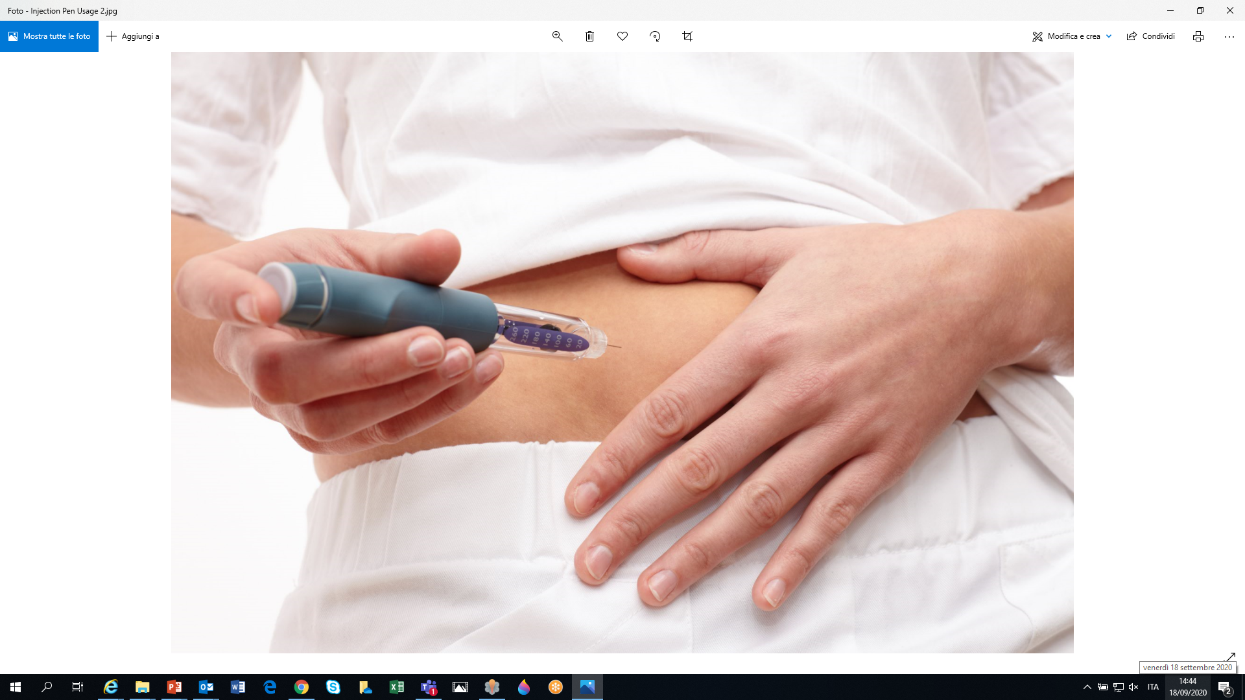
Trends in biologics delivery
Devices and Formulations
Notes:
After this introduction to Celanese, let us now switch gears and look into current trends in biologics delivery.

Slide 3
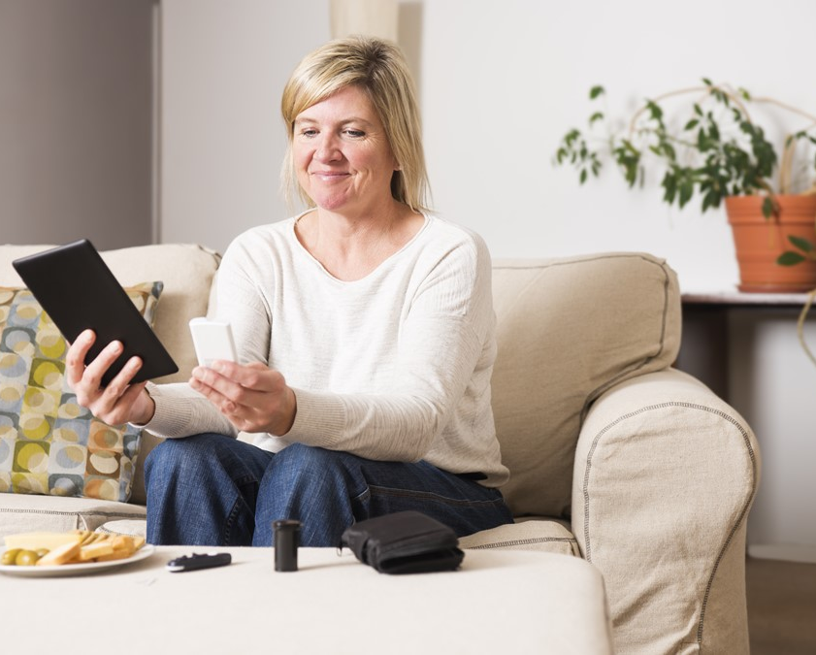
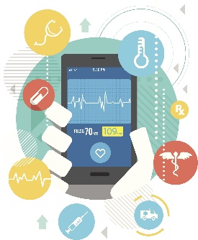
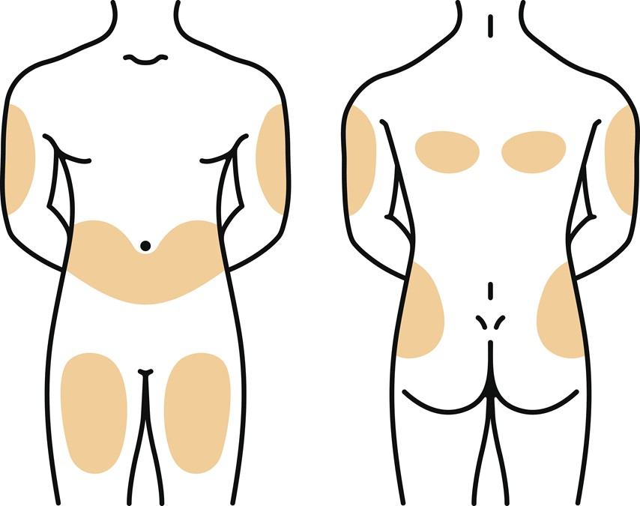
Market trends
Biologics
Large volume and viscosity
Costs containment
Home therapies
Patient centric-models
Subcutaneous self-administration,
Convenient, simple, intuitive, long & ultra-long acting
Digital health
Electronics and connectivity in the device, patient compliance, self-monitoring
Notes:
I believe we are all aware of noticeable trends in the delivery of biologics. While some details are certainly open for discussions, Celanese recognizes a clear trend towards larger volumes and higher solution viscosities in ever more complex injection devices, as new biologics suitable for sub-cutaneous self-administration come to the market. This allows a shift from hospital based treatments to home therapy, which helps to contain costs and resources in healthcare systems. At the same time long-acting formulations and connected smart devices will ensure or even improve patient compliance and outcome.

Slide 4
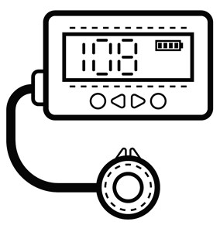
Evolution of biologics delivery solutions
Long-acting parenterals
Wearable pumps
Smart & connected injection devices
Injection Pens &
Auto-injectors
Patient outcome
Pre-filled syringes
Intravenous dosing
VitalDose® EVA
Vectra® MT® LCP
Vectra® MT® LCP
Hostaform® MT® POM
Celanex® MT® PBT
SlideX® MT® tribo
Medical grade color service
CoolPoly®
Vectra® LCP-LDS
Hostaform® MT® POM
Celanex® MT® PBT
Pibiflex® TPE
Ateva® G EVA & LDPE
Dosage form innovation
Celanese materials support broadest range of biologics delivery solution
Notes:
The evolution in biologics delivery is driven by continuous innovation of existing dosage forms and devices. Moving from pre-filled syringes to more advanced injection devices like smart autoinjectors or wearable pumps results in increased patient outcome through a more patient friendly delivery, more reliable dosing and better delivery controls. We believe that microneedle patches and injectable long-acting depot formulations of new high-affinity & potent biologics will enable efficient & reliable dosing of biologics on levels currently not achieved.
Celanese actively supports development of these innovative delivery devices and drug formulations through our materials and technology innovations. In the next parts of this presentation I will outline our solutions for advanced injection devices, wearable pumps and depot formulations in more detail.

Slide 5
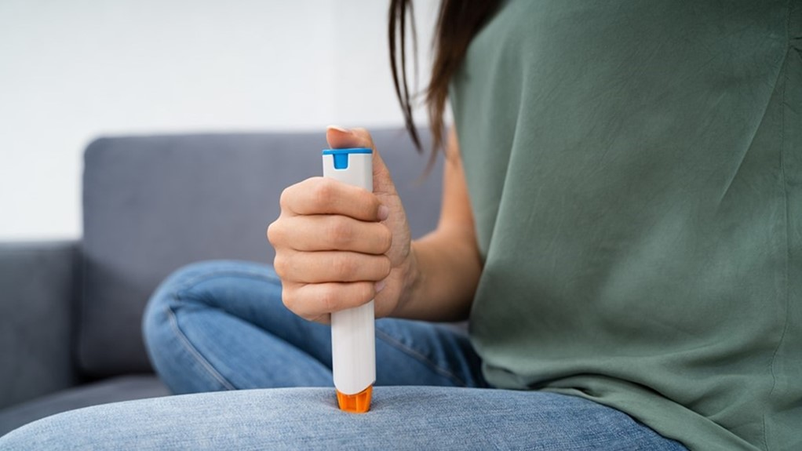
Autoinjector material selection
Product requirements and material selection

Slide 6
Concept of an Autoinjector
Shroud
Procedure
Define the specifications
Define the operating conditions
Define pre-existing material requirements
Build an interaction matrix for the concept
Determine best material interactions
Chose material based on product performance
Case
Syringe
Return Spring
Return Sleeve
Main Spring
Driver
Button Spring
Release
Button

Slide 7
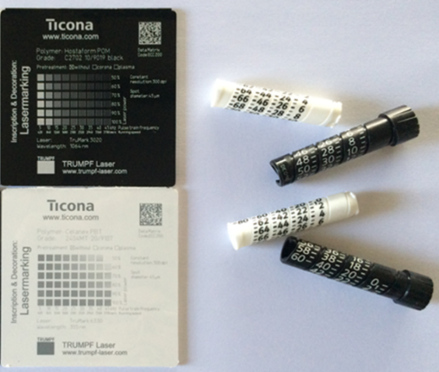
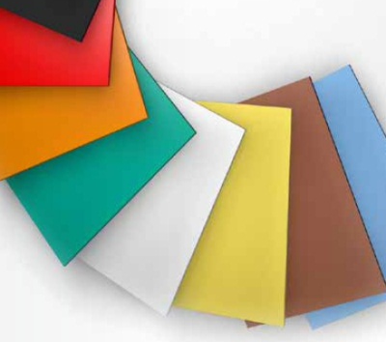
Concept of an Autoinjector Product requirements
Polymer with internal or external lubricant
Friction Performance
Noise Generation
Good sliding performance vs. sliding partner(s)
Disposable or re-usable
Laser marking (Sharp, crisp indelible images on low gloss or high gloss surfaces)
Colors
Precision (e.g. dosing accuracy)
Sterilization
Celanese
Celanese
additional..

Slide 8
The Importance of Tribology Concept of an Autoinjector
Shroud
Interaction Matrix | Case | Shroud | Main Spring | Return Spring | Syringe | Return Sleeve | Driver | Release | Button | Button Spring
Case |  | x | x | x |  | D | D | S | D | x |  | D
Shroud | x |  |  |  |  |  |  |  |  |  |  | Dynamic
Main Spring | x |  |  |  |  |  | D | D
Return Spring | x |  |  |  | x | D |  |  |  |  |  | S
Syringe |  |  |  | x |  | S |  |  |  |  |  | Static
Return Sleeve | x |  |  | x | x
Driver | x |  | x |  | x |  |  | D |  |  |  | X
Release | x |  | x |  |  |  | D |  | D | x |  | Not of concern in this analysis
Button | x |  |  |  |  |  |  | D |  | x
Button Spring | x |  |  |  |  |  |  | D | D
Case
Syringe
Return Spring
Return Sleeve
Main Spring
Driver
Button Spring
Release
Button

Slide 9
The Importance of Tribology Material Selection for an Autoinjector
Shroud
 |  | Lowest Performance |  | Highest Performance
Component | Key Requirements | Option 1 | Option 2 | Option 3
Return Sleeve | Very low friction on case & spring Impact strength | Hostaform® MT® POM 8U01 | Hostaform® MT® Slidex® POM 1203 | Vectra® MT® LCP 1335
Driver | High strength Low friction Low stick slip & noise | Hostaform® MT® POM 8U01 | Hostaform® MT® POM 8F01 | Hostaform® MT® Slidex® POM 2404
Release | High strength Snap fits Low friction/stick slip on driver | Celanex® MT® PBT 2401MT | Celanex® MT® PBT 2402MT | Hostaform® MT® Slidex® POM 1203
Button | Low stick slip Colorability | Hostaform® MT® POM 8U01 | Celanex® MT® PBT 2405MT | Celanex® MT® PBT 2404MT
Case
Syringe
Return Spring
Return Sleeve
Main Spring
Driver
Button Spring
Release
Button
Notes:
Return Sleeve: POM --> POM best tribo. Perf. --> highest stiffness + tribo
Driver: POM --> POM + PTFE --> POM best tribo. Perf. + better flow
Release: PBT --> PBT --> POM best tribo. Performance
Button: POM --> PBT + Wax (color perf. + tribo) --> PBT + PTFE (tribo++)

Slide 10
Medical wearable devices
Material differentiation and customer enabling capabilities

Slide 11
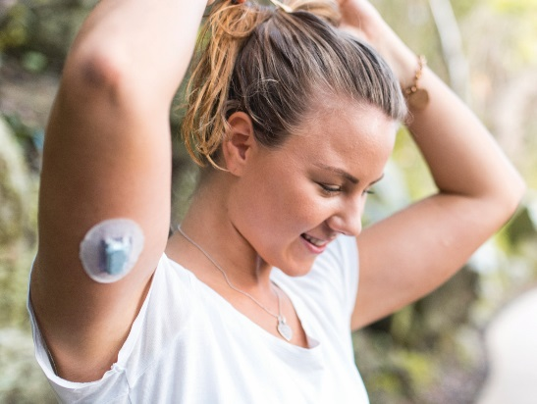
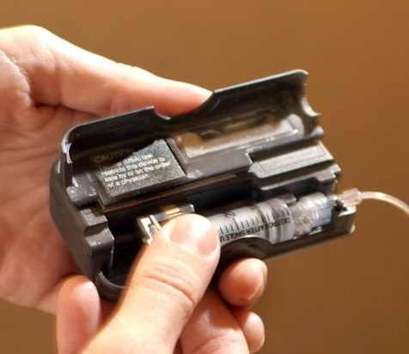
Celanese’s Differentiated Large Volume Wearable Pump Solutions with Vectra® MT® LCP, Hostaform® MT® SlideX® POM & Celanex® MT® SlideX® PBT
Internal Chassis Material Requirements
Opportunity Drivers
Excellent mechanical performance – high stiffness, tight tolerances, dimensional stability, and thinner wall capability to free internal space for integrated electronics and internal components
Managing processing costs – scalability through higher flow to fill higher cavity molds and reduce production cycle times
Growth in biologic development and reformulation of intravenous drugs is driving self-administered injections
Injection pumps enable higher volume and more frequent dosing – necessary for higher-viscosity formulations – through the use of larger capacity, prefilled cartridges
Patient adherence to treatment plans – which can increase with wearable pumps – further benefits from comfortable, lighter-weight, easier-to-use, and discreet devices
Gears, Bearings, & Sliding Parts Material Requirements
Excellent tribological and mechanical performance – low friction & wear, no noise, high strength/modulus, fatigue & creep resistance, and dimensional stability
Internal Chassis
Vectra® MT® LCP Enables thinner wall designs with higher dimensional stability, stiffness and higher flow for faster production
Gears, Bearings, & Sliding Parts
Hostaform® MT® SlideX® POM
Celanex® MT® SlideX® PBT Enables precision mechanical components with low friction & wear and no noise
External

Slide 12
CASE STUDY
LIGHTER-WEIGHT, INCREASED COMFORT, AND GREATER DESIGN FLEXIBILITY
VECTRA® MT® LCP 1305 LOWERS COST PER PART AND ENABLES IMPROVED DESIGN FOR PATCH PUMP CHASSIS
Customer Challenge
Customer Value
Celanese Solution & Capabilities
Design a wearable injection pump that allows patients manage their diabetes —with effective, low maintenance treatment approach
Deliver material solutions that manage overall device costs – as components are disposable
Requirements for a lightweight, cost-efficient wearable device:
Excellent mechanical performance, including dimensional stability, high stiffness and tight part tolerances for internal chassis
Improve production efficiency by allowing for higher cavity molds or shorter cycle times
Address increasing internal component needs and design flexibility (i.e., electronics integration, space for additional functionality)
Vectra® MT® LCP MT1305, a 15% glass-reinforced, higher-flow grade of LCP, enabled medical device designers to develop a thinner-walled, reduced-weight chassis and accelerate cycle times
Breadth of Polymers & Chemicals
Broad portfolio of Vectra® MT® LCP includes glass-filled, mineral-filled, higher-flow, tribologically modified (PTFE), and appearance grades – suitable for a variety of uses in medical device applications
Delivery of up to 50% per part cost savings versus incumbent material (Polycarbonate)
Provided greater productivity with shorter cycle times and increased multi-cavity tool (4x versus original)
Simplified design for increased flexibility for other components and eliminated plating step due to inherent flame retardancy
Extensive Functionality of Polymers
Modified grade provides extraordinary easy flow and low warpage – ideal for highly complex designs and for optimizing material use
Customer Enabling CAPABILITIES
MT® Polymer Service Package – Regulatory support, risk reduction, long-term supply.
Part Design & Processing – Industry-leading computer-aided engineering LCP design capabilities provides ability to conceptualize new part designs and incorporate material property advantages
higher flow AND CAE INSIGHTS ENABLED thinner wall DESIGN FOR IMPROVED END-USER EXPERIENCE AND REDUCED PER PART COST

Slide 13
Legal Disclaimer
Disclaimer & Notice to Users
Contact Information
This publication was printed based on Celanese’s present state of knowledge, and Celanese undertakes no obligation to update it. Because conditions of product use are outside Celanese’s control, Celanese makes no warranties, express or implied, and assumes no liability in connection with any use of this information. Nothing herein is intended as a license to operate under or a recommendation to infringe any patents.
Values shown are based on testing of laboratory test specimens and represent data that fall within the standard range of properties for natural material. These values alone do not represent a sufficient basis for any part design and are not intended for use in establishing maximum, minimum, or ranges of values for specification purposes. Colorants or other additives may cause significant variations in data values. Properties of molded parts can be influenced by a wide variety of factors including, but not limited to, material selection, additives, part design, processing conditions and environmental exposure. Any determination of the suitability of a particular material and part design for any use contemplated by the users and the manner of such use is the sole responsibility of the users, who must assure themselves that the material as subsequently processed meets the needs of their particular product or use.
To the best of our knowledge, the information contained in this publication is accurate; however, we do not assume any liability whatsoever for the accuracy and completeness of such information. The information contained in this publication should not be construed as a promise or guarantee of specific properties of our products. It is the sole responsibility of the users to investigate whether any existing patents are infringed by the use of the materials mentioned in this publication. Moreover, there is a need to reduce human exposure to many materials to the lowest practical limits in view of possible adverse effects. To the extent that any hazards may have been mentioned in this publication, we neither suggest nor guarantee that such hazards are the only ones that exist. We recommend that persons intending to rely on any recommendation or to use any equipment, processing technique or material mentioned in this publication should satisfy themselves that they can meet all applicable safety and health standards. We strongly recommend that users seek and adhere to the manufacturer’s current instructions for handling each material they use, and entrust the handling of such material to adequately trained personnel only.
The products mentioned herein are not intended for use in medical or dental implants.
Celanese®, registered C-ball design and all other trademarks identified herein with ®, TM, SM, unless otherwise noted, are trademarks of Celanese or its affiliates.
Hostaform® is a registered trademark of Hoechst GmbH, used by Celanese Corporation under license.
Fortron® is a registered trademark of Fortron Industries LLC, used by Celanese Corporation under license.
© 2020 Celanese or its affiliates. All rights reserved. Published September 2020
healthcare@Celanese.com
Americas
8040 Dixie Highway, Florence, KY 41042 USA
Product Information Service t: +1-800-833-4882 t: +1-859-372-3244
Customer Service t: +1-800-526-4960 t: +1-859-372-3214
Europe
Am Unisys-Park 1, 65843 Sulzbach, Germany
Product Information Service t: +(00)-800-86427-531 t: +49-(0)-69-45009-1011
Asia
4560 Jinke Road, Zhang Jiang Hi Tech Park Shanghai 201203 PRC
Customer Service t: +86 21 3861 9266 f: +86 21 3861 9599
13

